Slide 1
SYMPOSIUM PRE-CONFERENCE WORKSHOP
SUNDAY, OCTOBER 15, 2023 | 9:00 AM - 12:00 PM
An Introduction to Competency Frameworks for Students, Educators, and Leaders
PRESENTER:
Sandra Moumoutjis, Building 21

Slide 2
Presenter
Sandra Moumoutjis
Executive Director of the Learning Innovation Network
sandra@b-21.org

Slide 3
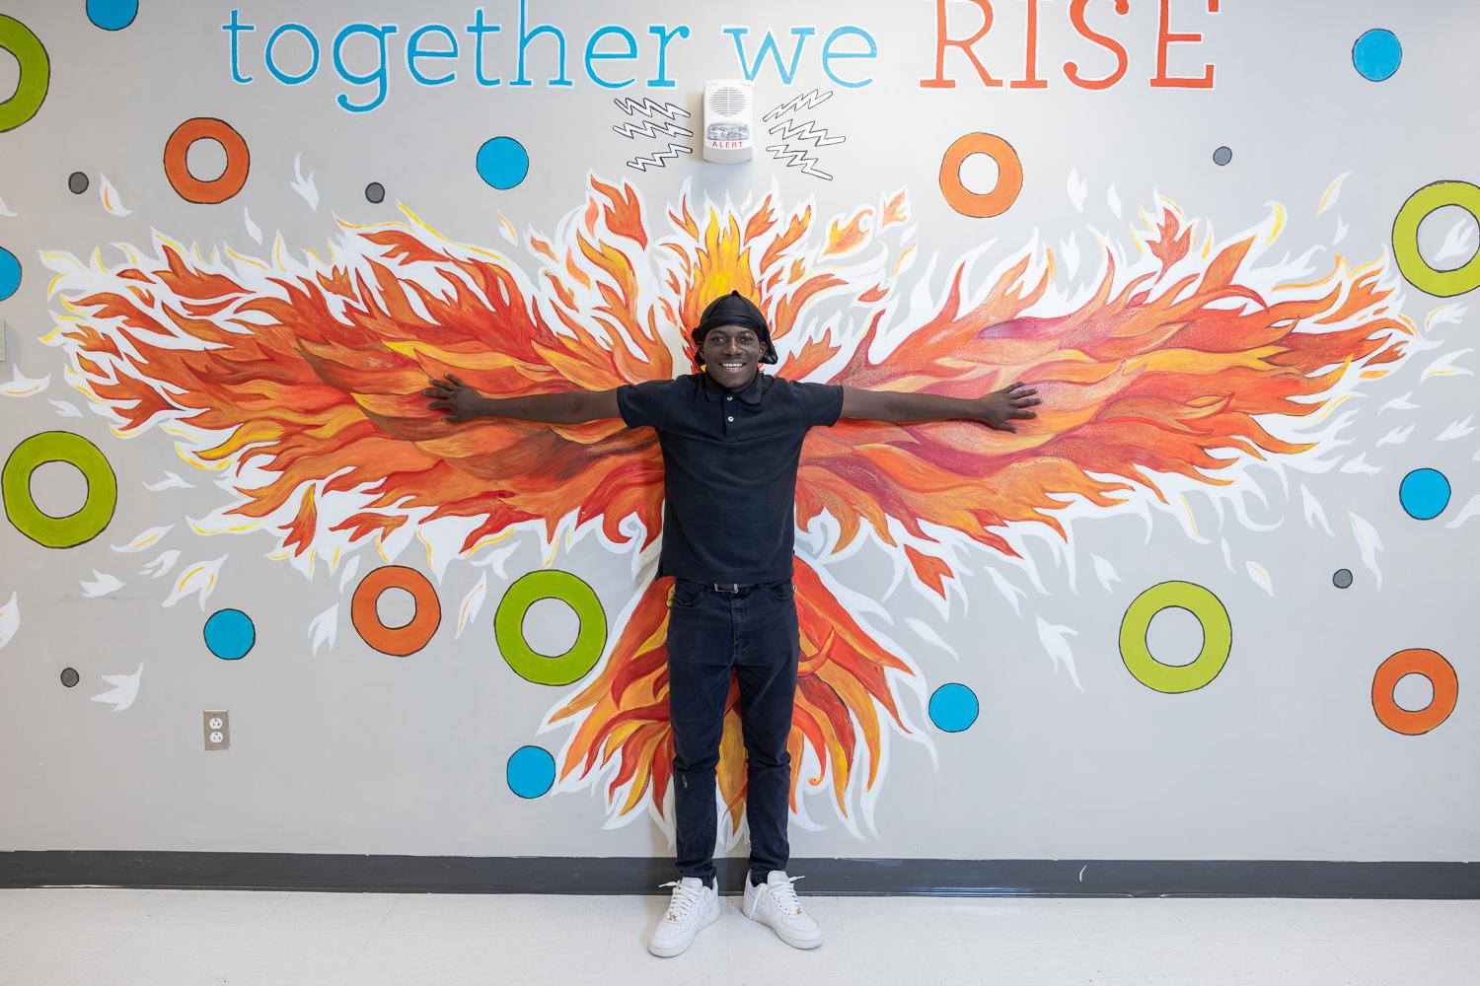
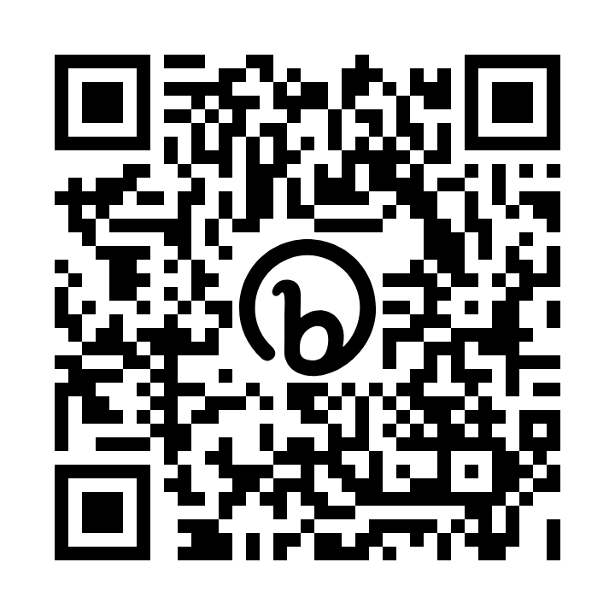
Slide Deck Link:
https://bit.ly/competencyframeworks
Sign up for a free account to access the resources in this session:
Ahttps://building21.org/member-register/

Slide 4
Welcome!
Join a group with a few people sitting near you and introduce yourself.
Answer this prompt: Think of something new that you are trying to learn or something that you have been getting better at over time. Take 15 seconds and describe where you are in the process of learning.

Slide 5
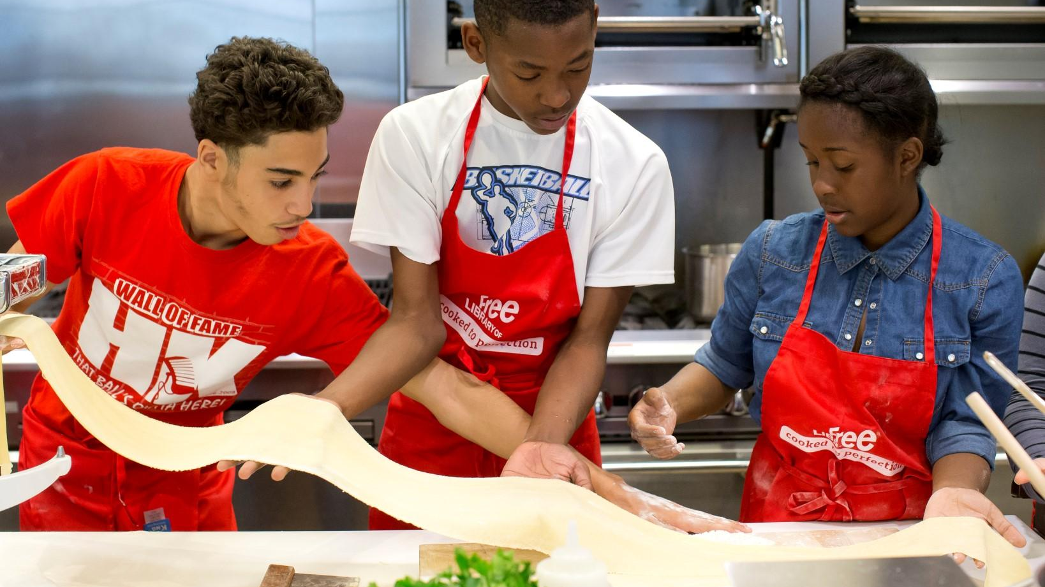
Goals for Today:
Understand the why behind competency-based learning progressions (continua)
Review and reflect on sets of open progression-based competency frameworks
Identify where you are in the CBE transformation process, where you would like to go, and your next steps to get there.

Slide 6
What can bike riding teach us about competency-based learning progressions?
Bike Riding Grading Form

Slide 7
What is CBE?
Competency-based education is a system in which:
Students are empowered daily to make important decisions about their learning experiences, how they will create and apply knowledge, and how they will demonstrate their learning.
Assessment is a meaningful, positive, and empowering learning experience for students that yields timely, relevant, and actionable evidence.
Students receive timely, differentiated support based on their individual learning needs.
Students progress based on evidence of mastery, not seat time.
Students learn actively using different pathways and varied pacing.
Strategies to ensure equity for all students are embedded in the culture, structure, and pedagogy of schools and education systems.
Rigorous, common expectations for learning (knowledge, skills, and dispositions) are explicit, transparent, measurable, and transferable.
A competency-based school should implement all seven elements of the definition. Strong implementation also requires policies, pedagogy, structures, and culture that support every student.

Slide 8
Competency Continuum
College & Career readiness!!
Performance Levels
College level work
Competency
Skill
Indicators
Link to Building 21 Student Competency Framework

Slide 9
Power of the Continua
Every competency has a continuum for each skill that tells students what learning looks like at each level.
The indicators on the continua are a guide for:
teachers to know what they need to teach students
students to know what they need to do to get to the next level
The continua is also used:
to give students timely and actionable feedback
for students to self-assess and give feedback to others
to rate students on their performance tasks

Slide 10
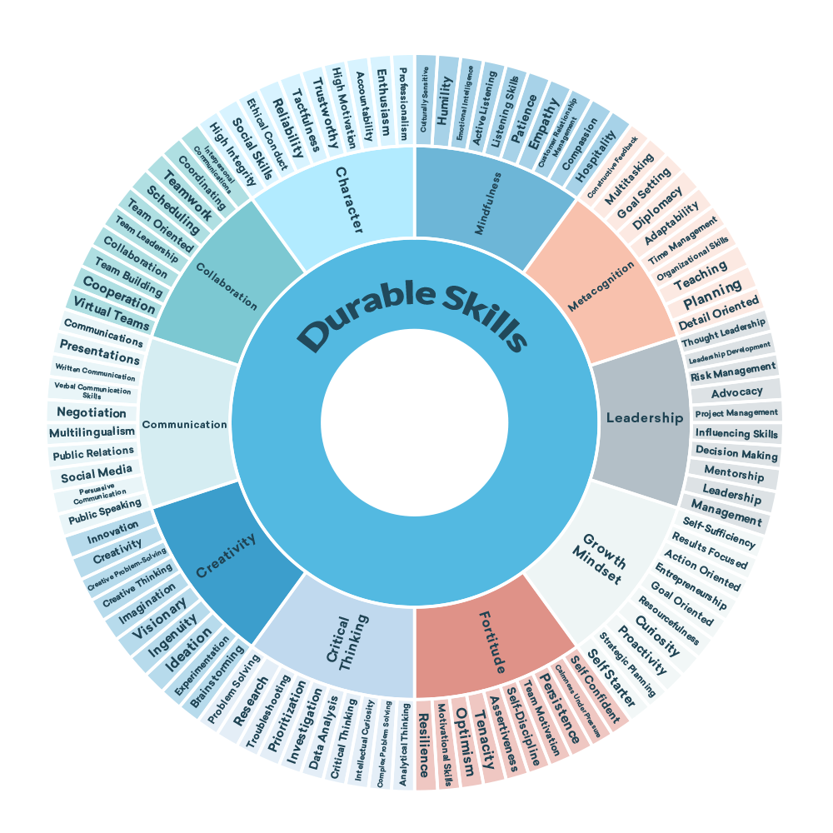
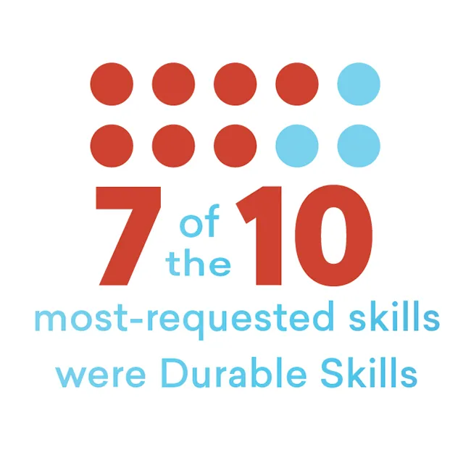
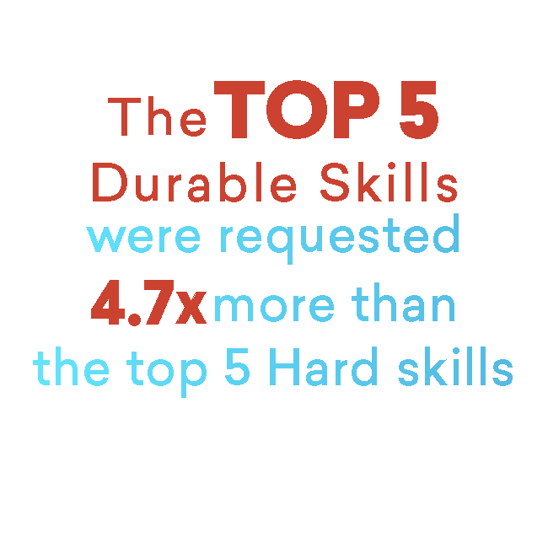
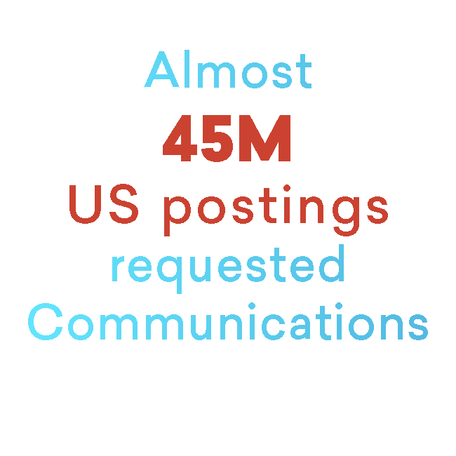
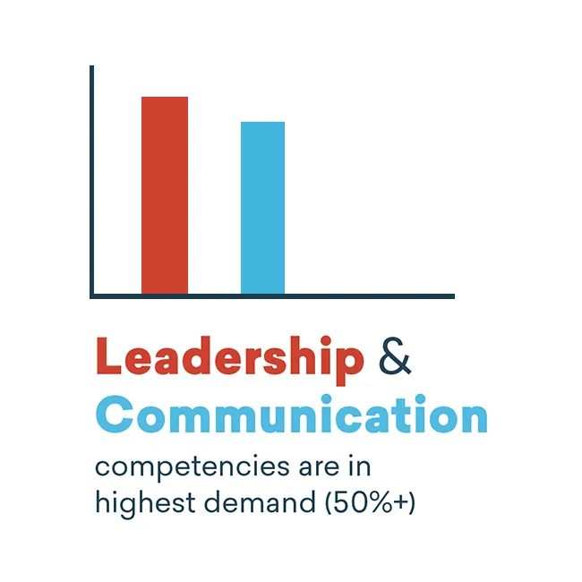
Durable skills

Slide 11
Open Competency Frameworks
Adopt,
Adapt,
Write!
(and use AI)
Notes:
Sandra

Slide 12
Competency Frameworks Exploration
As you are reviewing the competency frameworks, think about the following questions:
What do you notice? What questions do you have? How does this align to what you are already doing or your vision for competencies?
Fill out sticky notes on each Jamboard to tell share what you notice, what questions you have, and how it aligns to your vision.

Slide 13
Implementing Competency Frameworks
Implementing competency frameworks aligned to Aurora’s definition of CBE requires shifts in several key areas:
Mindset Shifts: Challenge your Thinking
School Culture Shifts: Build Strong and Meaningful Relationships
Instructional Shifts: Design for Engagement and Impact
Structural Shifts: Rethink Traditional Structures
Systems Shifts: Transparently Track and Communicate Progress and Growth

Slide 14
Self-Assessment
Review this DRAFT CBE Implementation Continua
Make a copy of the Google Doc or download in Word
On your own, with a partner, or in a small group, go through and self-assess (highlight) where your school or district is in each of the 5 shifts to CBE:
School Culture, Mindsets, Instruction, Structures, and Systems
Dive Deeper: As we think about where we are in our transition to implementing competency frameworks, what does this mean for the adults? Explore these leadership and teacher competencies:
Building 21 Teacher Competencies
Building 21 Leadership Competencies

Slide 15
Additional Resources
Here are some additional Building 21 resources for you to review:
Building 21 Student Competency Framework
Getting Started with CBE
CBE Starter Pack: Blog series written for CompetencyWorks
Summing up the Competency-Based Education Journey: Blog series written for CompetencyWorks
Ideas for Scheduling in a CBE Model
Studio Design Template
Inquiry-based Project Planner
Does Content Matter? Blog

Slide 16
Action Planning
Now that you have completed your self-assessment, here are some questions to guide your thinking and action planning:
Where am I in the transformation process?
What is my ideal vision of learning at my school/district/organization in five years?
What are my next steps?

Slide 17
Share Your Next Steps
What is one next step you will take on your journey to implementing your competency framework?
Fill out sticky notes on this Jamboard to tell us about your next steps.

Slide 18
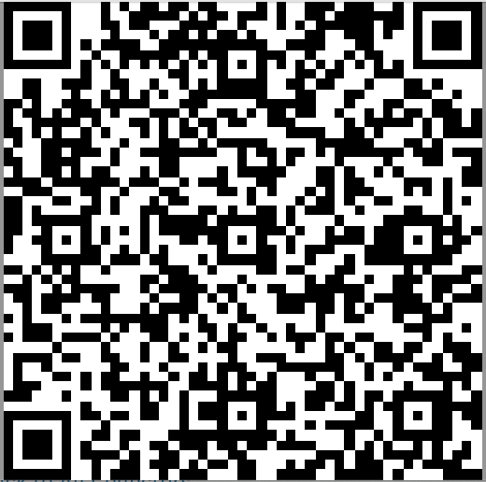
Thank you for joining us! Share your thoughts by participating in our one-minute poll: surveymonkey.com/r/Aurora_10-15_Frameworks
Notes:
Add link to session survey & QR Code

